Slide 1
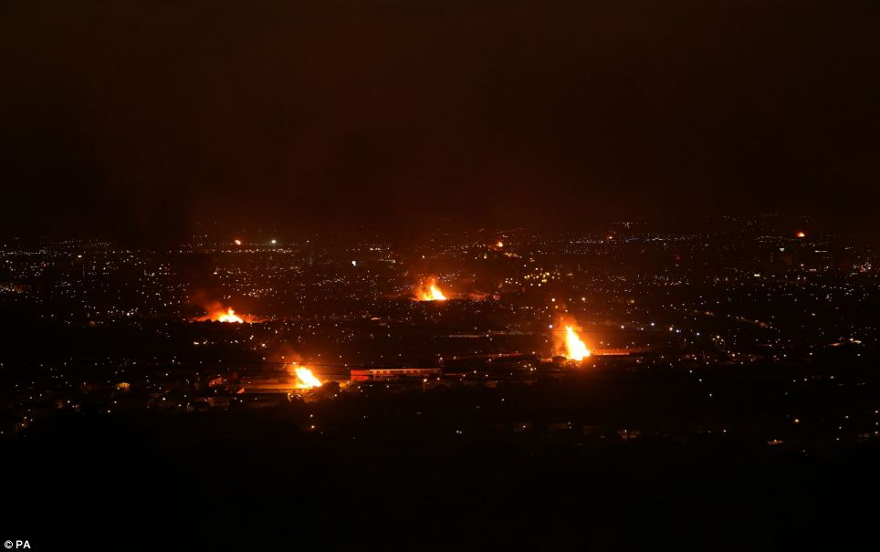
133
incidents in 2017
3000
palettes stolen from city council
2x
internationally accepted levels of pollution
Notes:
The amount of dangerous air pollution over Belfast during Bonfire night was more than double internationally acceptable levels (WHO)
2017 - over 3000 palettes were stolen from the belfast city council overnight
2017 - firefighters attended 133 incidents on the 11th night - rise of nearly 50% from 2016
vast majority of bonfires are supported by the community - interface areas - where bonfires might be dangerous

Slide 2
Bonfires & Nonfires
Sydenham Studios

Slide 3
Potentially toxic materials
Proximity to residential areas
Damage to property
Air pollution
Anti-social behaviour
Notes:
damage to property - 2015: prep of bonfire forced the evacuation of 52 homes on chobham street
tidy up
air pollution - particularly caused by burning hazardous materials
enable the council to put injunctions on bonfires quicker to prevent them from getting taller
residential areas
14 % of illegal tyre dumping in NI is for bonfires
“assess all reports and incidents considered to be more serious with either significant numbers of tyres... or where the illegal dumping concerns a pattern of repeat offending and/or organised crime.” - DAERA requirement

Slide 4
Improve living in Belfast
Building city data assets
Efficient Asset Management
Take the crime out of culture
Notes:
(Smart City Values) Inclusive Growth
Living here will get better – The neighbourhoods will be improved, the city living experience will be of a higher quality and improves community relations.
It will help grow the economy – Attracts investment and foster’s business growth.
It will encourage city development – Drives the physical and cultural regeneration of the city centre, as well as protects and enhances our environment and built heritage.
We can get smarter in maximising maintenance budgets and maintaining the significant public estate by identifying potentially dangerous and damaging bonfires early and seeking to limit their growth.

Slide 5
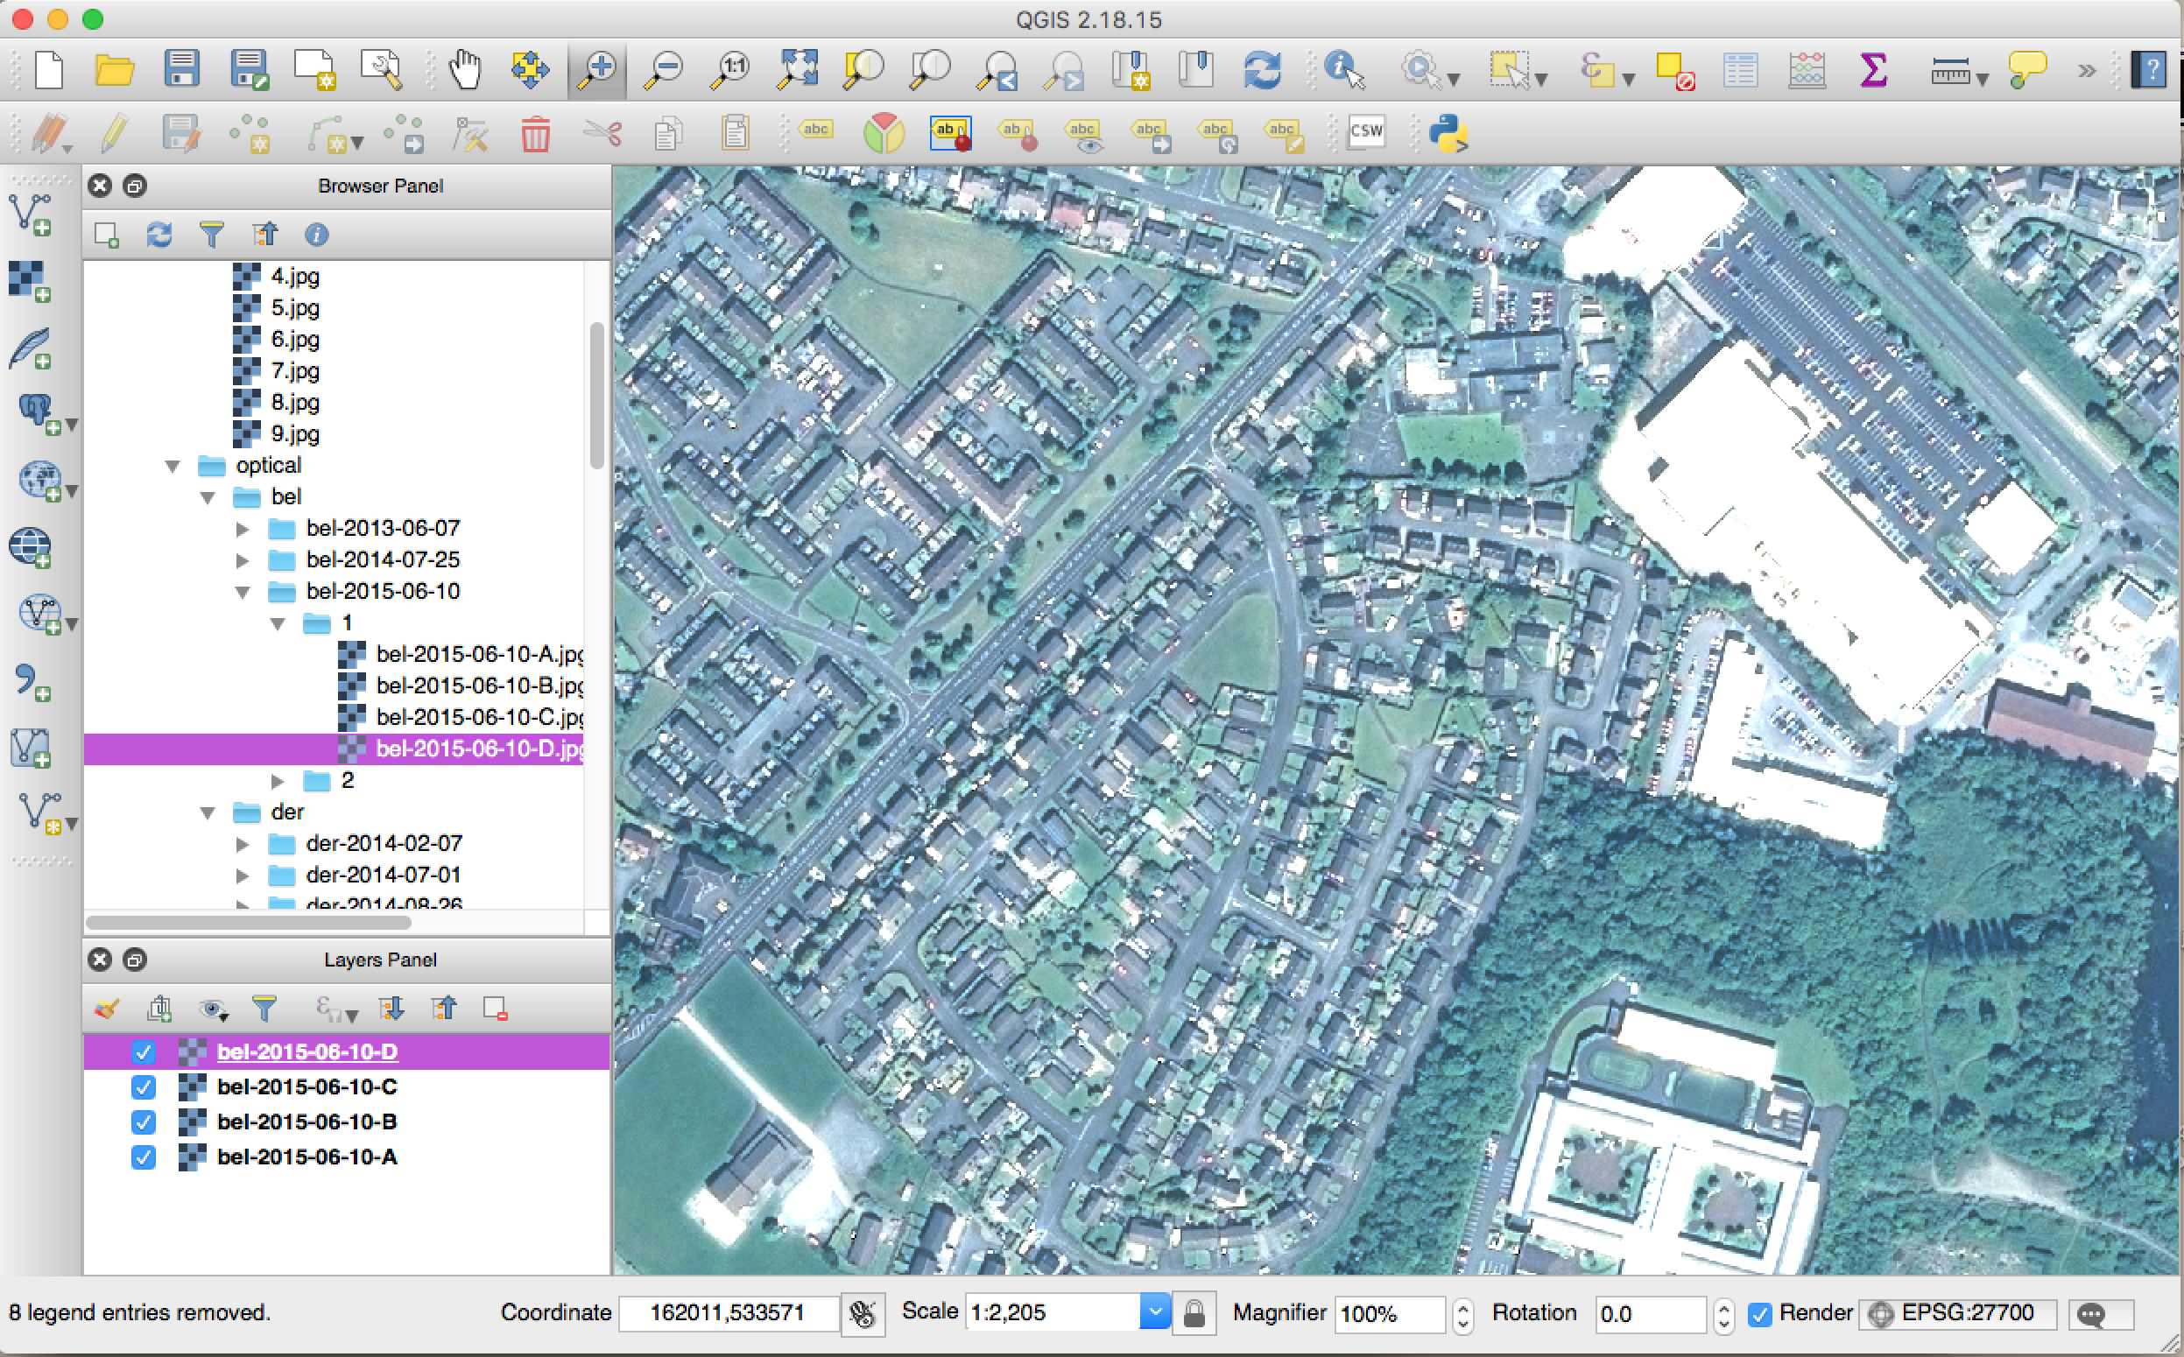
Notes:
Vision processing tool open sourced by Kainos, which uses Tensorflow: an open source machine learning framework, Flask, Keras
QGIS to process the large satellite imagery provided by Airbus

Slide 6
Notes:
Because of technical issues using QGIS on windows machines, we used some satellite imagery from google satellite as well - you can see the vast improvement in imagery between the two datasets and if we can get something similar from Airbus we could make some really accurate predictions

Slide 7
Notes:
Identify bonfires from satellite imagery using vision processing
Used Airbus data and google satellite data to generate a large dataset of images - split into training and testing data. We have already trained it so we’ll try it out now to see how well it’s able to predict the presence of bonfires.
DEMO START
Tensorflow gives us a prediction accuracy that’s consistently in the high 90s, but realistically it’s probably more likely to be in the 60s and 70s after just one night of hacking. But with high resolution images we could get a really high accuracy.

Slide 8
Notes:
DEMO RETURN

Slide 9
Ensures bonfires are following regulations
Detect unapproved bonfires
Predict damage to property
Allow the council to requests injunctions on bonfires earlier
Notes:
Ensures bonfires are following regulations
detect unapproved bonfires
predict damage to property - by monitoring proximity - in order to prevent
Allow the council to requests injunctions on bonfires earlier - preventing them from getting too tall

Slide 10
Bonfires & Nonfires
Sydenham Studios
Mark Bailie
Bob Beck
Claire Burn
Zoe Gadon-Thompson
Rebecca Martin
Mary-Jane McBride

